Slide 1
Jagged Arrays
Prepared By: Dimple Bohra

Slide 2
Jagged / Irregular Arrays
Irregular arrays are a kind of n-dimensional (n>1) arrays
It is an array of arrays where each element is, in turn, an array.
A special feature of this type of array is that it is a Multidimensional array whose each element can have different sizes.
For Example, a two-dimensional array in Java is an array of single dimension array. In the case of a two-dimensional array, each one-dimensional array will have different columns.

Slide 3
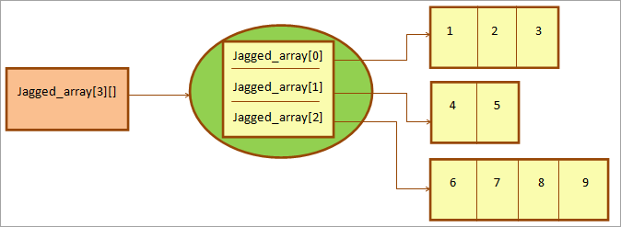
Pictorial representation of Jagged Array
Notes:
From the above pictorial representation, we got an idea of how does it look. Above shown is a two-dimensional Jagged array. Each individual element of this array is a one-dimensional array that has varied sizes as shown above.
The first 1D array has 3 columns; the second row has 2 columns while the third has 4 columns.

Slide 4
Examples of different types of jagged arrays
int[][] A = new int[3][5]; // regular array
int[][] B = new int[3][];
int[][][] C = new int[3][4][];
int[][][] D = new int[3][][];
int[][][] E = new int[][][];

Slide 5
Difference Between regular and jagged array
In a regular array, the number of elements in each dimension is known in advance. This number is set at the time of allocating memory for the array with the new operator.
In an jagged array, the number of elements in at least one dimension is unknown. This number may vary within this dimension

Slide 6
Create & Initialize Jagged Array
While creating an array of arrays you only specify the first dimension that represents a number of rows in the array.
Declaration :
int a[][]= new int[3][];
Instantiation of three single dimensional arrays
int a[0] = new int[2];
int a[1] = new int[3];
int a[2] = new int[4];
Notes:
a two-dimensional array is declared with three rows.
The first statement above indicates that the first row in the 2D array will have 2 columns. The second row will have 3 columns while the third row will have 4 columns thereby making it a Jagged array.
Once the array is created, you can initialize it with values. Note that if you don’t explicitly initialize this array (as in the above case), then it will take the default values as initial values depending on the data type of the array.

Slide 7
Initialization of jagged array
int[][] myarray ={
new int[] { 1, 2, 3 };
new int[] { 4, 5, 6, 7 };
new int[] { 8, 9 };
};
int[][] arr = {
{ 1, 2, 3 },
{ 4, 5, 6, 7 },
{ 8, 9 } };

Slide 8
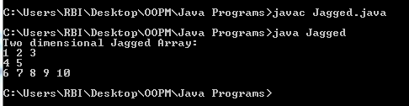
Program for initializing jagged array
class Jagged
{
public static void main(String[] args)
{
// Declare a 2-D array with 3 rows
int myarray[][] = new int[3][];
// define and initialize jagged array
myarray[0] = new int[]{1,2,3};
myarray[1] = new int[]{4,5};
myarray[2] = new int[]{6,7,8,9,10};
// display the jagged array
System.out.println("Two dimensional Jagged Array:");
for (int i=0; i<myarray.length; i++)
{
for (int j=0; j<myarray[i].length; j++)
System.out.print(myarray[i][j] + " ");
System.out.println();
}
}
}
Notes:
This program initializes a jagged array by assigning initial values to each row. Here each row of the array is initialized to the column values.

Slide 9
Program for initializing jagged array
class Jagged
{
public static void main(String[] args)
{
int[][] myarray={{1,2,3},{4,5},{6,7,8,9,10}};
// display the jagged array
System.out.println("Two dimensional Jagged Array:");
for (int i=0; i<myarray.length; i++)
{
for (int j=0; j<myarray[i].length; j++)
System.out.print(myarray[i][j] + " ");
System.out.println();
}
}
}
int myarray[][] = new int[3][];
myarray[0] = new int[]{1,2,3};
myarray[1] = new int[]{4,5};
myarray[2] = new int[]{6,7,8,9,10};

Slide 10
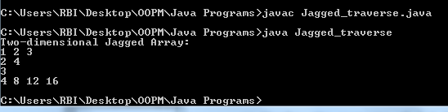
Program for initializing jagged array using loop
class Jagged_traverse {
public static void main(String[] args)
{
// Declaring 2-D array with 4 rows
int intArray[][] = new int[4][];
// create a jagged array
intArray[0] = new int[3];
intArray[1] = new int[2];
intArray[2] = new int[1];
intArray[3] = new int[4];
// Initializing array with values
for (int i=0; i<intArray.length; i++)
for(int j=0; j<intArray[i].length; j++)
intArray[i][j] = (i+1) * (j+1);
// display the contents of 2-D jagged array
System.out.println(“2D Jagged Array:");
for (int i=0; i<intArray.length; i++)
{
for (int j=0; j<intArray[i].length; j++)
System.out.print(intArray[i][j] + " ");
System.out.println();
}
}
}

Slide 11


